Slide 1
12th project : Implementation of MPEG-1
By
Mohamed Gouda
Ibrahim Ahmed
Salma Ibrahim
Nada Ahmed
Under supervision
Prof. Dr. Wesam Askar
Eng. Mohamed Abdalnaby Abdalfatah Alsayed

Slide 2
Objective
Implement a Matlab project that encode and decode a file or live stream video based on motion compensation approaches. You may choose the H.261, MPEG-1 or MPEG-2 compression standards. Also, at least one of the search methods taken in lectures (sequential, 2D logarithmic or hierarchal) should be used to detect the best match macroblocks and to compute the motion vectors.

Slide 3
Project Idea
We read a video in AVI file format. The MATLAB function videoReader will read the entire video. This project uses one base layer and one enhancement layer. Also, this project codes the luma component only. The first picture is intracoded and stored in the buffer. Subsequent pictures are predictive coded with a quantization step size of 16 and a quantizer scale of 4 for all the differential DCT coefficients. This forms the base layer.

Slide 4
Project Idea
The difference between the actual DCT and the quantized/dequantized DCT in the base layer is then quantized with a quantization step of 4 for all the coefficients. This additional data is the enhancement layer. Both base and enhancement layers are variable length coded and transmitted or stored. For lower quality video, only the base layer is decoded. To obtain a higher quality video, both layers are decoded. It does not calculate the bit rate nor does it generate the VLC codes. The aim is to illustrate the idea of SNR scalability. However, the codes follow the P-picture coding and quantization rules of MPEG-2

Slide 5
MPEG
MPEG: Moving Pictures Experts Group, established in 1988 for the development of digital video.
It is appropriately recognized that proprietary interests need to be maintained within the family of MPEG standards:
Accomplished by defining only a compressed bitstream that implicitly defines the decoder.
The compression algorithms, and thus the encoders, are completely up to the manufacturers.

Slide 6
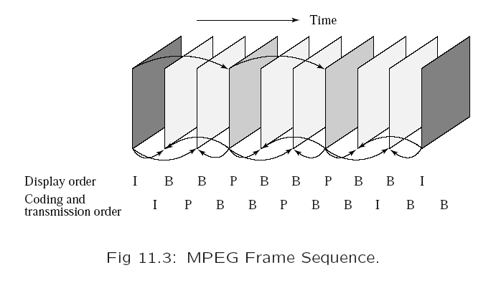
Motion Compensation in MPEG

Slide 7
MPEG-2
MPEG-2: For higher quality video at a bit-rate of more than 4 Mbps.
Defined seven profiles aimed at different applications:
Simple, Main, SNR scalable, Spatially scalable, High, 4:2:2, Multiview.
Within each profile, up to four levels are defined (Table 11.5).
The DVD video specification allows only four display resolutions:
720x480, 704x480, 352x480, and 352x240,
a restricted form of the MPEG-2 Main profile at the Main and Low levels.

Slide 8
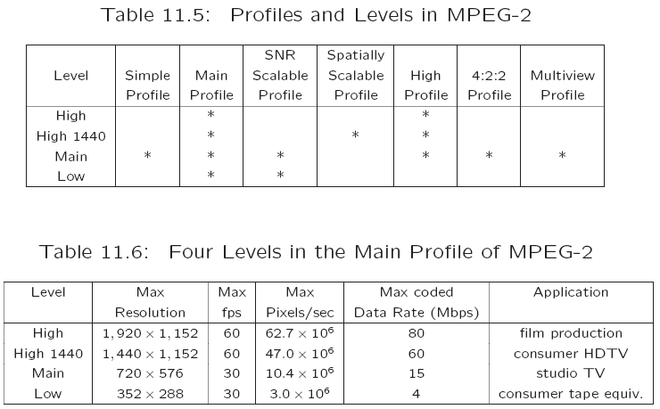
MPEG-2

Slide 9
Supporting Interlaced Video
MPEG-2 must support interlaced video as well since this is one of the options for digital broadcast TV and HDTV.
In interlaced video each frame consists of two fields, referred to as the top-field and the bottom-field.
In a Frame-picture, all scanlines from both fields are interleaved to form a single frame, then divided into 16x16 macroblocks and coded using MC.
If each field is treated as a separate picture, then it is called Field-picture.

Slide 10
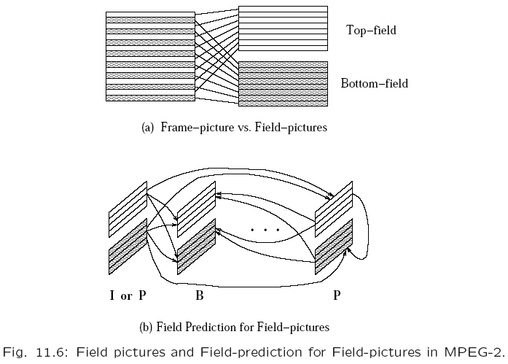
Supporting Interlaced Video

Slide 11
Five Modes of Predictions
MPEG-2 defines Frame Prediction and Field Prediction as well as five prediction modes:
Frame Prediction for Frame-pictures:
Identical to MPEG-1 MC-based prediction methods in both P-frames and B-frames.
Field Prediction for Field-pictures:
A macroblock size of 16x16 from Field-pictures is used. Fig. 11.6(b).

Slide 12
Five Modes of Predictions
Field Prediction for Frame-pictures:
The top-field and bottom-field of a Frame-picture are treated separately.
Each 16x16 macroblock (MB) from the target Frame-picture is split into two 16x8 parts, each coming from one field.
Field prediction is carried out for these 16x8 parts in a manner similar to that shown in Fig. 11.6(b).

Slide 13
Five Modes of Predictions
16x8 MC for Field-pictures:
Each 16x16 macroblock (MB) from the target Field-picture is split into top and bottom 16x8 halves.
Field prediction is performed on each half.
This generates two motion vectors for each 16x16 MB in the P-Field-picture, and
up to four motion vectors for each MB in the B-Field-picture.
This mode is good for a finer MC when motion is rapid and irregular.

Slide 14
Five Modes of Predictions
Dual-Prime for P-pictures:
Field prediction from each previous field with the same parity (top or bottom) is made.
Each motion vector mv is then used to derive a calculated motion vector cv in the field with the opposite parity taking into account the temporal scaling and vertical shift between lines in the top and bottom fields.
For each MB the pair mv and cv yields two preliminary predictions.
Their prediction errors are averaged and used as the final prediction error.
This mode mimics B-picture prediction for P-pictures without adopting backward prediction (and hence with less encoding delay).
This is the only mode that can be used for either Frame pictures or Field-pictures.

Slide 15
Alternate Scan and Field DCT
Techniques aimed at improving the effectiveness of DCT on prediction errors, only applicable to Frame-pictures in interlaced videos.
Due to the nature of interlaced video the consecutive rows in the 88 blocks are from different fields, there exists less correlation between them than between the alternate rows.
Alternate scan recognizes the fact that in interlaced video the vertically higher spatial frequency components may have larger magnitudes and thus allows them to be scanned earlier in the sequence.
In MPEG-2, Field_DCT can also be used to address the same issue.

Slide 16
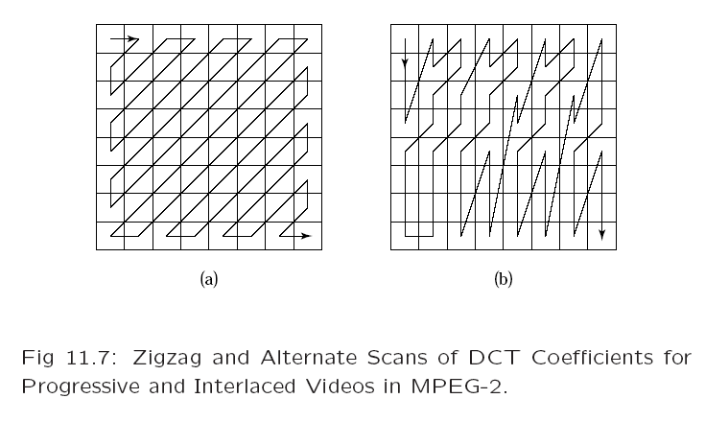
Alternate Scan and Field DCT

Slide 17
MPEG-2 Scalabilities
The MPEG-2 scalable coding (layered coding): A base layer and one or more enhancement layers can be defined.
The base layer can be independently encoded, transmitted and decoded to obtain basic video quality.
The encoding and decoding of the enhancement layer is dependent on the base layer or the previous enhancement layer.

Slide 18
MPEG-2 Scalabilities
Scalable coding is especially useful for MPEG-2 video transmitted over networks with following characteristics:
Networks with very different bit-rates.
Networks with variable bit rate (VBR) channels.
Networks with noisy connections.

Slide 19
MPEG-2 Scalabilities
MPEG-2 supports the following scalabilities:
SNR Scalability: enhancement layer provides higher SNR.
Spatial Scalability: enhancement layer provides higher spatial resolution.
Temporal Scalability: enhancement layer facilitates higher frame rate.
Hybrid Scalability: combination of any two of the above three scalabilities.
Data Partitioning: quantized DCT coefficients are split into partitions.

Slide 20
SNR Scalability
SNR scalability: Refers to the enhancement/refinement over the base layer to improve the Signal-Noise-Ratio (SNR).
The MPEG-2 SNR scalable encoder will generate output bitstreams Bits base and Bits enhance at two layers:
At the Base Layer, a coarse quantization of the DCT coefficients is employed which results in fewer bits and a relatively low quality video.
The coarsely quantized DCT coefficients are then inversely quantized (Q⁻¹) and fed to the Enhancement Layer to be compared with the original DCT coefficient.
Their difference is finely quantized to generate a DCT coefficient refinement, which, after VLC, becomes the bitstream called Bits enhance.

Slide 21
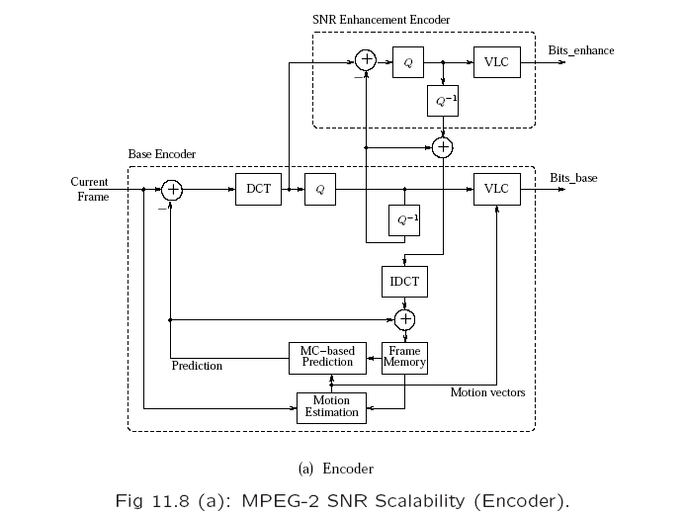
SNR Scalability

Slide 22
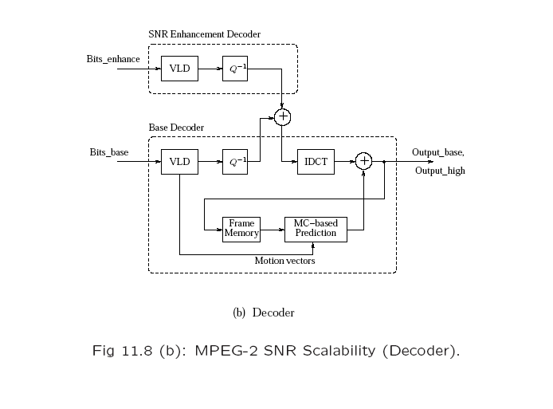
SNR Scalability

Slide 23
Implementation
SNR scalable video coding using motion compensated prediction
Block motion is estimated to an integer using full search and SAD matching metric.
Block size is 8 x 8 pixels.
Search window size is 16 x 16 pixels.
The differential block is 2D DCT transformed, quantized using uniform quantizer with constant quantization step of 16.
The reconstructed block becomes the reference block for the next input frame.
Base layer carries the above quantized data.
The enhanced layer is created by coding the difference between the unquantized DCT coefficients and the base layer quantized DCT coefficients and then quantizing this differential DCT with a different quantization step.
Decoding the base layer yields a lower quality video and adding the enhanced layer to the base layer results in a higher quality video.
Only intensity (Luma) image sequence is accepted.

Slide 24
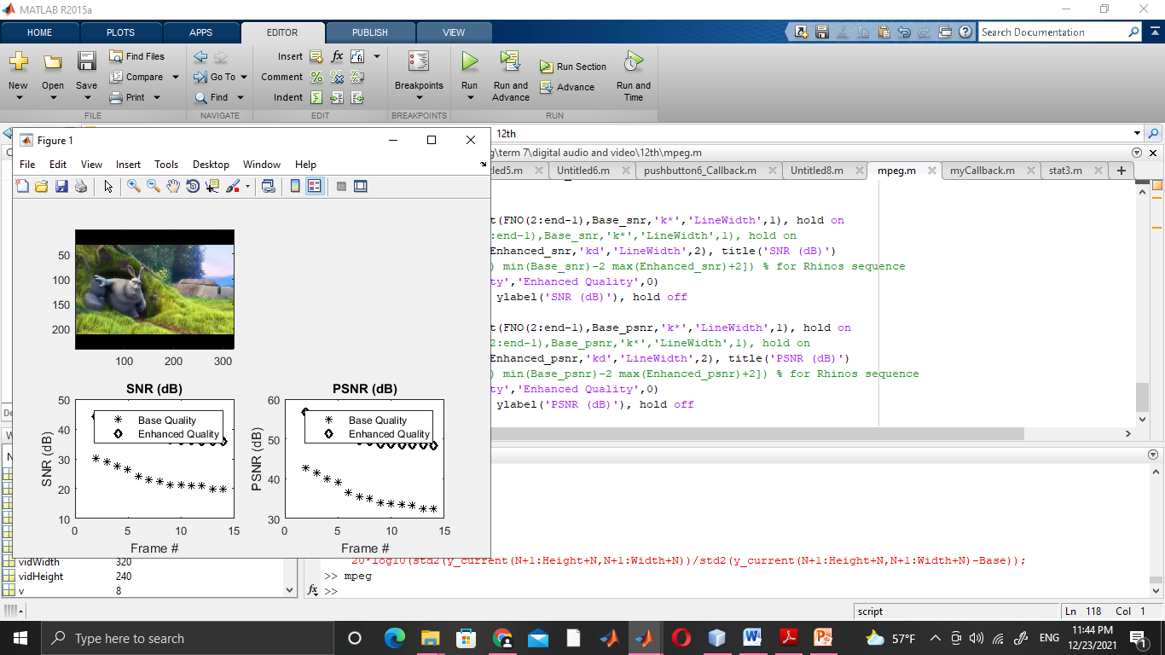
Results and Discussion
SNR and PSNR values for a video sequence using spatial scalable MPEG coding: (a) video sequence consists of 15 frames (b) SNR in dB and (c) PSNR in dB. The frames used are 2 through 15, inclusive.

Slide 25
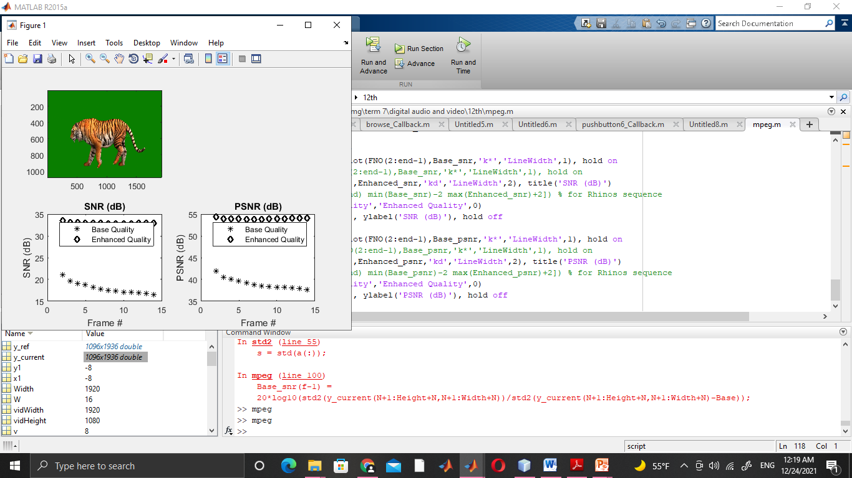
Results and Discussion
SNR and PSNR values for a tiger video sequence using spatial scalable MPEG coding: (a) video sequence consists of 15 frames (b) SNR in dB and (c) PSNR in dB. The frames used are 2 through 15, inclusive.

Slide 26
References
[1] Introduction to Digital Audio and Video Fundamentals, lecture Notes, Dr. Wesam askar, 2021
[2] Robert M. Goodman, Patrick McGrath "Editing Digital Video: The Complete Creative and Technical Guide" 2007
[3] K. S. Thyagarajan, STILL IMAGE AND VIDEO COMPRESSION WITH MATLAB, John Wiley & Sons, Inc, 2011.

